Slide 1

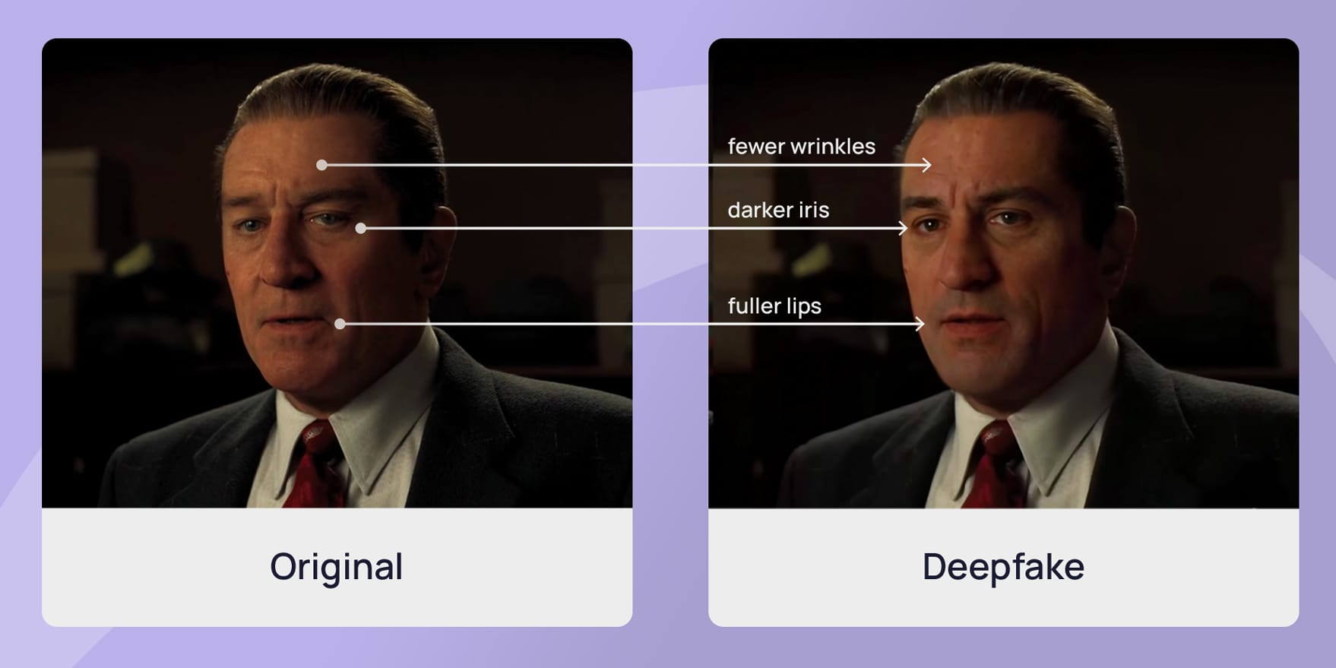
DEPARTMENT OF COMPUTER SCIENCE ENGINEERING
MAJOR PROJECT :
A PRIVACY PRESERVING & ACCESSIBLE DEEP FAKE VIDEO DETECTION SYSTEM USING FACE BASED ANALYSIS
Guided by: Prof. Vijay Kumar M. Awatiger
Team members: Mustafeez Shaikh
Sakib M Goundi
Sanjana Jinaral
Sanskriti Singh

Slide 2

CONTENT WE WILL SEE :
Introduction
Problem Statement
Objectives
Literature Survey
System Overview
System Flow & Architecture
Methodology
Implementation
Result & Discussion
Advantage & Limitations
Conclusion & Future Scope
References

Slide 3
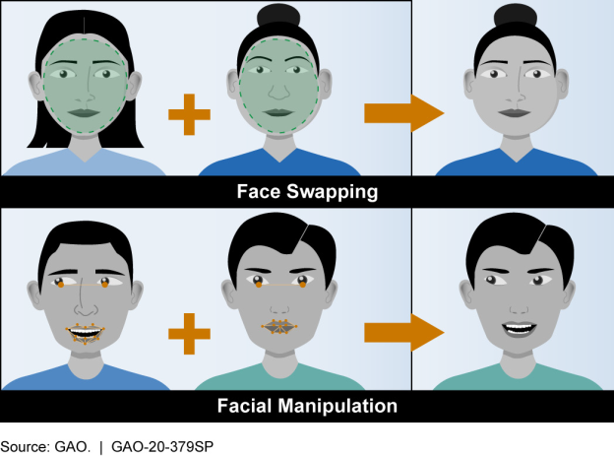
INTRODUCTION:
Deep Fake videos are AI-generated manipulated videos that alter facial expressions, movements.
Recent advancements in deep learning have made Deep Fakes highly realistic.
Deep Fakes are misused for misinformation, fraud, identity theft, and political manipulation.
Manual detection by humans is unreliable due to high visual realism.
Hence, automated Deep Fake detection systems are necessary.
Facial regions show most manipulation artifacts, making face-based analysis effective.

Slide 4
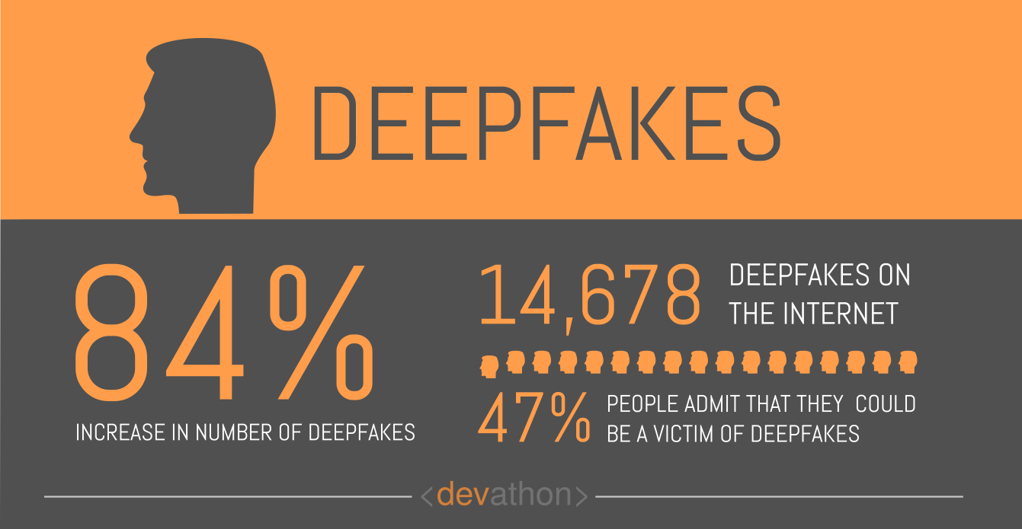
PROBLEM STATEMENT:
Deep Fake videos are becoming increasingly realistic and widespread.
Common users lack reliable tools to verify video authenticity.
Existing Deep Fake detection tools:
  Require technical expertise
  Are not publicly accessible
  Often compromise user privacy by storing there details
There is no simple, secure, and efficient solution available for public use.
Identifying whether a video is real or manipulated remains a major challenge.

Slide 5

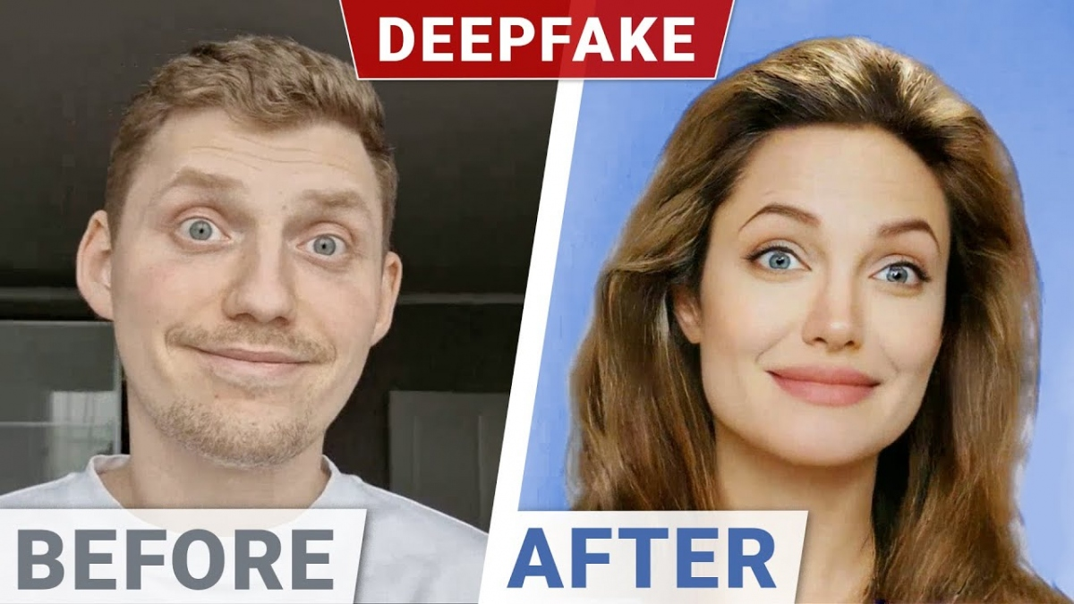
OBJECTIVES:
To develop a publicly accessible Deep Fake video detection system.
To ensure user privacy by avoiding permanent data storage.
To analyze facial features for identifying video manipulation.
To classify videos as REAL or FAKE with a confidence score.
To design a system that is easy to use for non-technical users.

Slide 6
LITERATURE SURVEY:
Sno. | Author | Year | Paper Title | Contribution | Limitation
1. | Md. Ferdous, S. A. Fattah, A. K. Bashar | 2023 | An EfficientNet-based Deepfake Classification Framework for Social Media | Uses EfficientNet CNN for accurate deepfake video classification, aligning with our model choice | Does not consider user privacy or public accessibility
2. | Huy Dang, Feng Liu, Julian Stehouwer,Anil K. Jain | 2022 | On the Detection of Digital Face Manipulation | Focuses on detecting facial manipulation artifacts, directly supporting face-based analysis | High computational complexity
3. | Yuezun Wu, Xuan Jiang, Yandong Ren | 2022 | Deepfake Video Detection with Spatiotemporal Attention | Combines spatial and temporal features for video-level detection | Requires high processing resources
4. | Peng Sun, Di Zhang, Tao Liu | 2021 | DeepFake Detection Using Biological Signals | Explores facial physiological signals for detecting deepfakes | Complex feature extraction and implementation
5. | Andreas Rössler, Davide Cozzolino, Luisa Verdoliva, Christian Riess, | 2019 | FaceForensics++: Learning to Detect Manipulated Facial Images | Provides a standard benchmark dataset for training and evaluation | Limited generalization to unseen manipulations

Slide 7
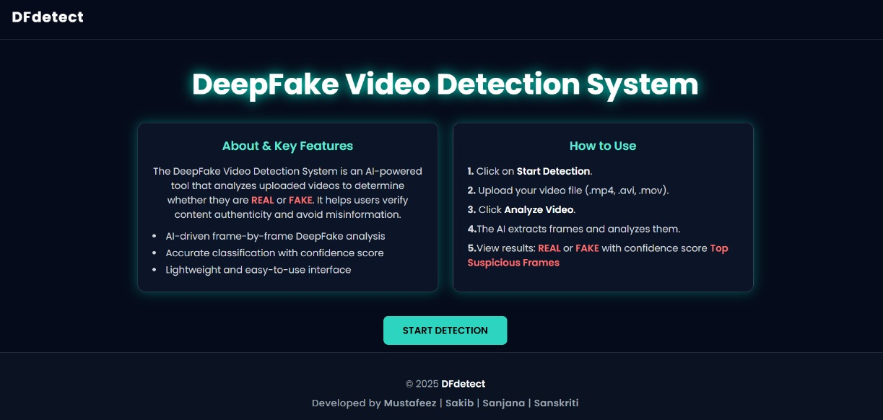
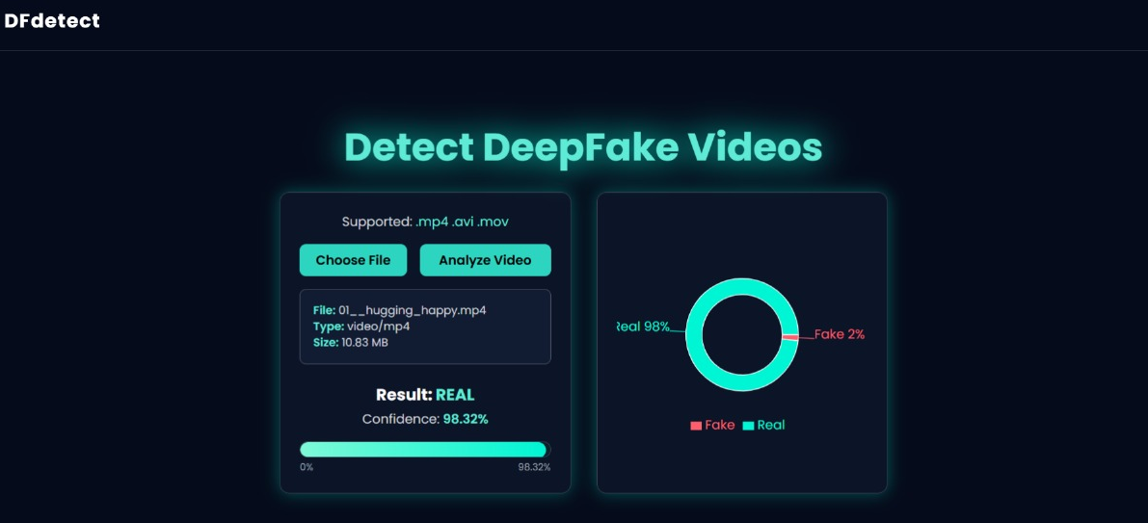
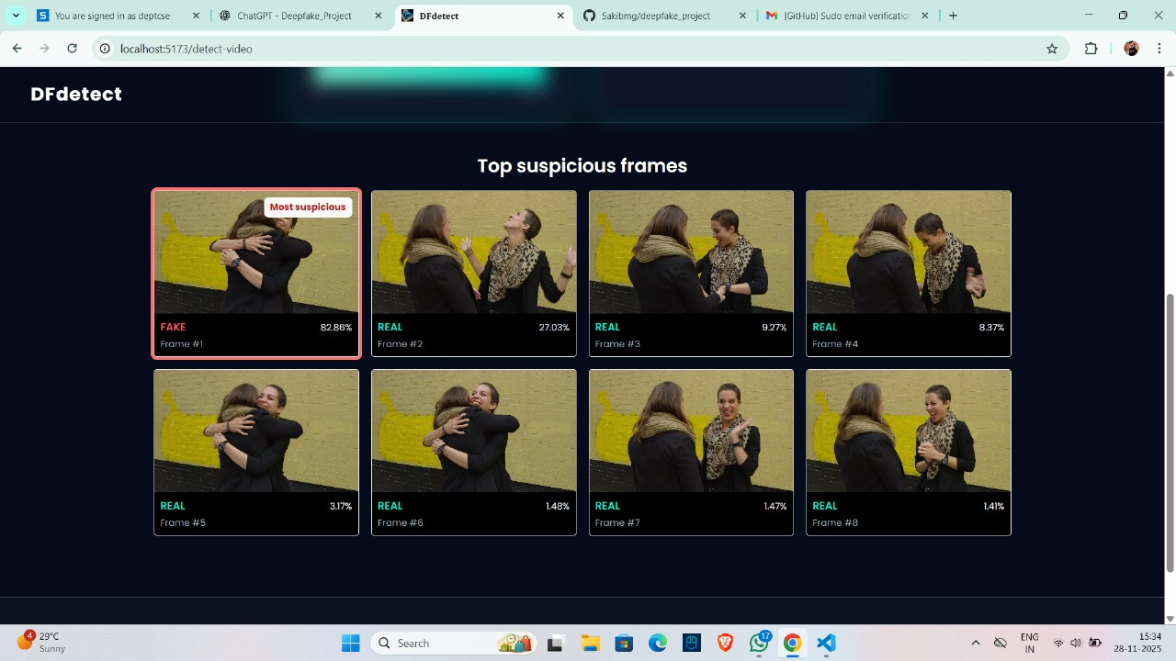
SYSTEM OVERVIEW:
Web-based Deep Fake detection system.
User uploads a video.
System processes the video temporarily.
Facial regions are analyzed using deep learning.
Output includes:
  REAL / FAKE classification
  Confidence score
  Top 8 suspicious frames

Slide 8
SYSTEM FLOW & ARCHITECTURE:
System flow:
Video Upload
Frame Extraction
Face Detection
Preprocessing
Classification
Aggregation
Result Display
Architecture consists of:
Frontend (ReactJS)
Backend (Flask API)
ML Core (EfficientNet-B7 + MTCNN)
System Flow System Architecture

Slide 9
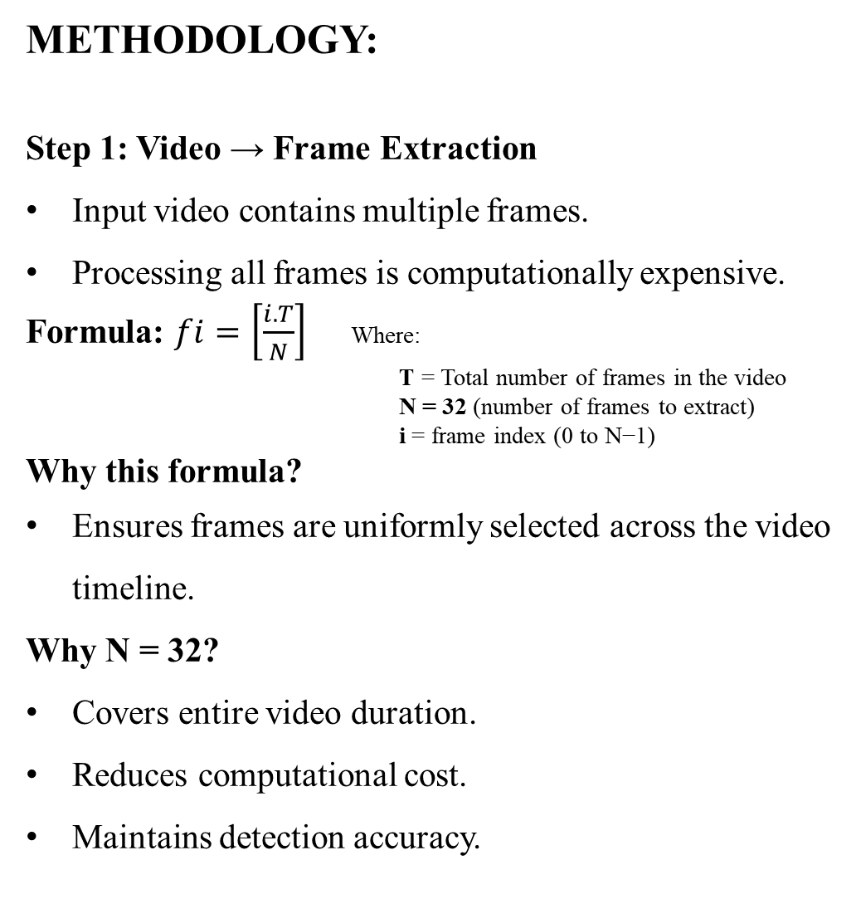
METHODOLOGY:
Step 1: Video → Frame Extraction
Input video contains multiple frames.
Processing all frames is computationally expensive.
Formula: $fi=\left[\frac{i.T}{N}\right]$ Where:
T = Total number of frames in the video
N = 32 (number of frames to extract)
i = frame index (0 to N−1)
Why this formula?
Ensures frames are uniformly selected across the video timeline.
Why N = 32?
Covers entire video duration.
Reduces computational cost.
Maintains detection accuracy.
Deep fake workflow diagram

Slide 10
METHODOLOGY:
Step 2: Frames → Face Regions
Faces are detected and aligned using MTCNN.
Only facial regions are extracted from frames.
Why face-based processing?
Deep Fake artifacts mainly appear on faces.
Improves accuracy.
Preserves user privacy.

Slide 11
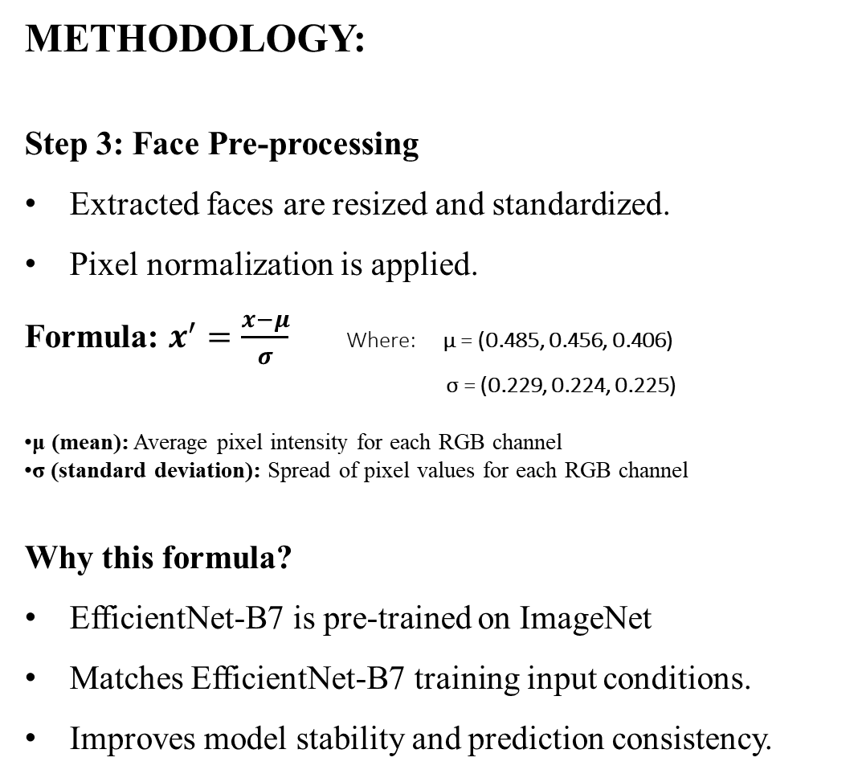
METHODOLOGY:
Step 3: Face Pre-processing
Extracted faces are resized and standardized.
Pixel normalization is applied.
Formula: $x^{′}=\frac{x−μ}{σ}$ Where: μ = (0.485, 0.456, 0.406)
σ = (0.229, 0.224, 0.225)
μ (mean): Average pixel intensity for each RGB channel
σ (standard deviation): Spread of pixel values for each RGB channel
Why this formula?
EfficientNet-B7 is pre-trained on ImageNet
Matches EfficientNet-B7 training input conditions.
Improves model stability and prediction consistency.

Slide 12
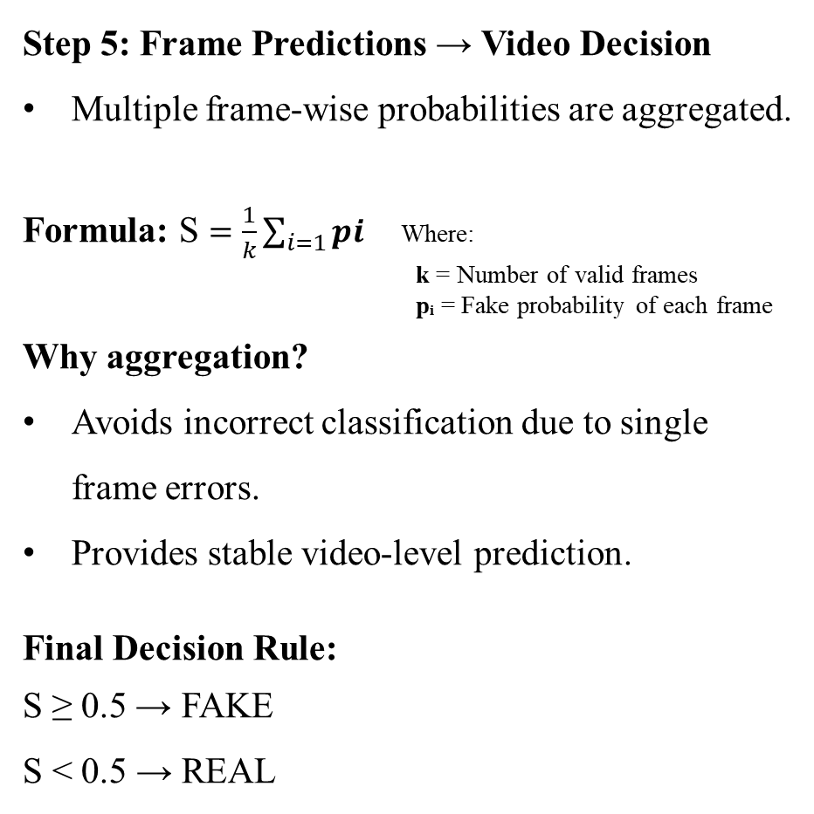
METHODOLOGY:
Step 4: Frame-wise Prediction
Each pre-processed face is passed to EfficientNet-B7.
Model outputs a fake probability per frame.
Output:
p ∈ [0,1]
  p ≈ 0 → REAL
  p ≈ 1 → FAKE
Step 5: Frame Predictions → Video Decision
Multiple frame-wise probabilities are aggregated.
Formula: S $=\frac{1}{k}\sum_{i=1}{pi}$ Where:
k = Number of valid frames
pᵢ = Fake probability of each frame
Why aggregation?
Avoids incorrect classification due to single frame errors.
Provides stable video-level prediction.
Final Decision Rule:
S ≥ 0.5 → FAKE
S < 0.5 → REAL

Slide 13
IMPLEMENTATTION:
Frontend Implementation (ReactJS)
Role of Frontend
Allows users to upload videos
Displays detection results
Key Features
Video upload with format validation
Loading indicator during processing
Displays:
  REAL / FAKE result, Confidence score, Suspicious frames
Why ReactJS is used:
Fast and responsive UI
Easy integration with backend APIs

Slide 14
IMPLEMENTATTION:
Backend Implementation (Flask API)
Role of Backend
Acts as a bridge between frontend and ML core
Manages video upload and processing workflow
Key Responsibilities
Receives video file from frontend &Temporarily stores the video
Triggers the ML detection pipeline
Collects prediction results
Sends response back to frontend
Why Flask is used:
Lightweight and fast. Ideal for ML-based APIs & Easy integration with Python models

Slide 15
IMPLEMENTATTION:
Machine Learning Core Implementation
Components:
Frame Extraction Module: Extracts uniformly sampled frames from video
Face Detection Module (MTCNN): Detects and aligns faces & Crops facial regions only
Pre-processing Module: Resizes faces to 380×380 & Applies normalization
Deep Fake Classification Module: EfficientNet-B7 predicts fake probability per frame
Aggregation Module: Averages frame-wise probabilities & Produces final video-level decision
Why PyTorch is used:
Strong support for deep learning
Efficient GPU/CPU execution
Easy model integration

Slide 16
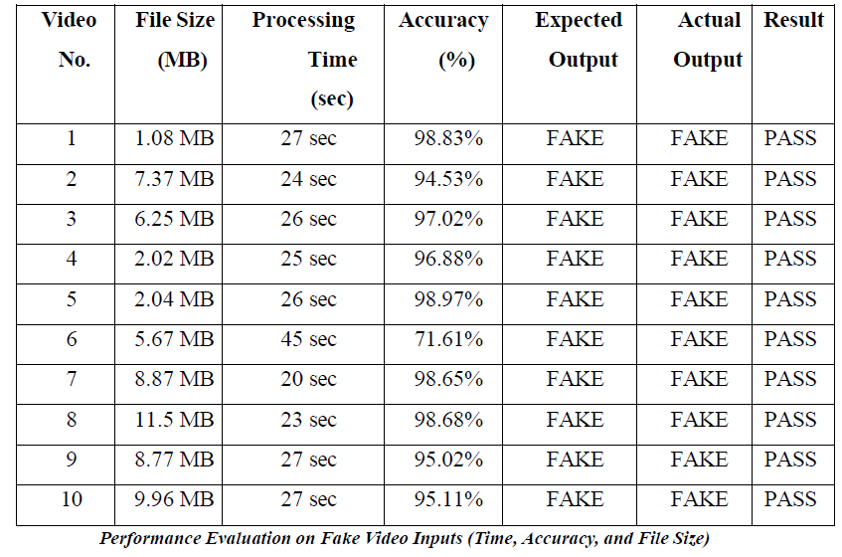
RESULT & DISCUSSION:
Results on FAKE Videos
Observations
High output achieved for most fake videos:
  Accuracy range: 95% – 99%
One video showed lower accuracy due to:
  Large file size, Poor lighting, Complex facial motion
Processing time ranged between 20–45 seconds
Discussion
Fake videos require more processing time because:
  Presence of manipulation artifacts
  More complex facial distortions
High accuracy confirms the model’s ability to detect:
  Texture inconsistencies
  Unnatural facial blending
  GAN-generated artifacts
System Performance on Fake Videos

Slide 17
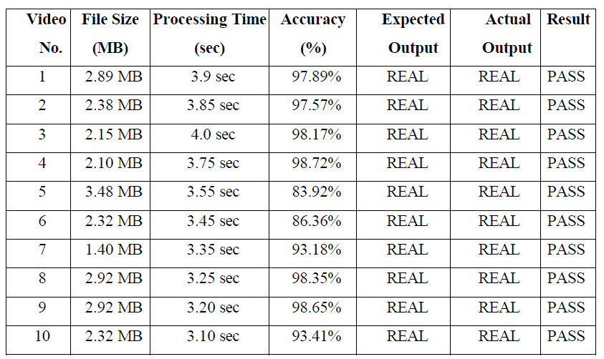
RESULT & DISCUSSION:
Results on REAL Videos
Observations
Output range: 93% – 98%
Processing time was significantly lower:
  3–4 seconds per video
No real video was misclassified as fake
Discussion
Faster processing is due to:
  Absence of manipulation artifacts
  Cleaner facial textures
Low false-positive rate shows:
  Model reliability
  Good generalization capability
System Performance on Fake Videos

Slide 18
ADVANTAGES AND LIMITATIONS:
Advantages
High Detection Accuracy
Privacy-Preserving Processing
Face-Based Analysis
User-Friendly Web Interface
Reliable Video-Level Decision
Limitations
Sensitive to Poor Lighting Conditions
Higher Processing Time for Fake Videos
Audio Deep Fakes Not Detected
Limited Multi-Face Handling
Dataset Dependency

Slide 19
CONCLUSION & FUTURE SCOPE:
Conclusion
This project successfully developed a Deep Fake video detection system using face-based analysis.
The system accurately classifies videos as REAL or FAKE using deep learning techniques.
Experimental results show high detection accuracy with minimal misclassification.
The use of frame sampling and aggregation ensures stable video-level decisions.
Privacy is preserved by not storing user data, making the system suitable for public use.
Future Scope
Audio Deep Fake Detection: Extend the system to analyze manipulated audio along with video.
Real-Time Video Detection: Support live video streams for real-time Deep Fake detection.
Multi-Face Video Analysis: Enhance the system to handle multiple faces in group videos.

Slide 20
REFERENCES:
[1] Md. Ferdous, S. A. Fattah, and A. K. Bashar,
“An EfficientNet-based Deepfake Classification Framework for Social Media,”
Journal of Intelligent & Fuzzy Systems, vol. 44, no. 1, pp. 951–963, 2023.
[2] Yuezun Wu, Xuan Jiang, and Yandong Ren,
“Deepfake Video Detection with Spatiotemporal Attention,”
Pattern Recognition, vol. 130, pp. 108–120, 2022.
[3] Huy Dang, Feng Liu, Julian Stehouwer, Xiaoming Liu, and Anil K. Jain,
“On the Detection of Digital Face Manipulation,”
IEEE Transactions on Pattern Analysis and Machine Intelligence, vol. 44, no. 4, pp. 2313–2327, 2022.
[4] Peng Sun, Di Zhang, and Tao Liu,
“DeepFake Detection Using Biological Signals,”
IEEE Transactions on Information Forensics and Security, vol. 16, pp. 4578–4593, 2021.
[5] Andreas Rössler, Davide Cozzolino, Luisa Verdoliva, Christian Riess, Justus Thies, and Matthias Nießner,
“FaceForensics++: Learning to Detect Manipulated Facial Images,”
In Proceedings of the IEEE/CVF International Conference on Computer Vision (ICCV), 2019.

Slide 21


